Slide 1




Doctor Appointment System
For Arba Minch General Hospital

Slide 2
Content
We are going to see
1
2
Chapter one
Chapter two
- Introduction to the Project
- Problem Statements
- Relevance of the Project
- Project Scope and Objectives
- System Architecture
- System Components
- Class Diagram
- Database Design – ER Diagram
3
Chapter three
4
Chapter FOUR
- User Interfaces
- Implementation Details - Technologies & Tools
- Testing Methodologies
- Validation and Results
5
Chapter five
- Challenges Faced
- Future enhancements
1
Notes:
how the admin change the hard coded timeslot for patients to select? first they are hard code timeslots but if later required how to do so? the project is done in flutter and laravel for backend and api.

Slide 3
Chapter one
Introduction to the project
Our project aims to develop a comprehensive appointment system for a hospital. The purpose of this system is to streamline and simplify the process of booking, managing, and reviewing medical appointments.

Slide 4






Statement of Problem
Manual Appointment Handling
Patient Dissatisfaction
Scalability Issues
Limited Doctor Information
Results in overloaded tasks
Lost or Misplaced Files
Limited Flexibility
Reduced Efficiency
Due to long wait times
Lack of Reminders
Feedback mechanism
Patients with busy schedule
More patients, more paperwork
Chance of double bookings
Reduced patient confidence
Potential for missed opportunities
Notes:
Scheduling appointments might be restricted to office hours,
files get lost or shuffled, Limited information can lead to patient uncertainty, A lack of knowledge about the doctor can contribute to a less satisfying patient experience
In many hospitals, the process of managing appointments is primarily manual, leading to several inefficiencies and challenges.
Forgetting appointment – missed appts.
If patients can't access information about the doctor's specialties, they might miss out on services they could benefit from

Slide 5

Statement of Problem
Manual Appointment Handling
Patient Dissatisfaction
Scalability Issues
Limited Doctor Information
Results in overloaded tasks
Lost or Misplaced Files
Limited Flexibility
Reduced Efficiency
Due to long wait times
Lack of Reminders
Feedback mechanism
Patients with busy schedule
More patients, more paperwork
Chance of double bookings
Reduced patient confidence
Potential for missed opportunities
Notes:
Scheduling appointments might be restricted to office hours,
files get lost or shuffled, Limited information can lead to patient uncertainty, A lack of knowledge about the doctor can contribute to a less satisfying patient experience
In many hospitals, the process of managing appointments is primarily manual, leading to several inefficiencies and challenges.
Forgetting appointment – missed appts.
If patients can't access information about the doctor's specialties, they might miss out on services they could benefit from

Slide 6
Statement of Problem
Manual Appointment Handling
Patient Dissatisfaction
Scalability Issues
Limited Doctor Information
Results in overloaded tasks
Lost or Misplaced Files
Limited Flexibility
Reduced Efficiency
Due to long wait times
Lack of Reminders
Feedback mechanism
Patients with busy schedule
More patients, more paperwork
Chance of double bookings
Reduced patient confidence
Potential for missed opportunities
Notes:
Scheduling appointments might be restricted to office hours,
files get lost or shuffled, Limited information can lead to patient uncertainty, A lack of knowledge about the doctor can contribute to a less satisfying patient experience
In many hospitals, the process of managing appointments is primarily manual, leading to several inefficiencies and challenges.
Forgetting appointment – missed appts.
If patients can't access information about the doctor's specialties, they might miss out on services they could benefit from

Slide 7

Statement of Problem
Manual Appointment Handling
Patient Dissatisfaction
Scalability Issues
Limited Doctor Information
Results in overloaded tasks
Lost or Misplaced Files
Limited Flexibility
Reduced Efficiency
Due to long wait times
Lack of Reminders
Feedback mechanism
Patients with busy schedule
More patients, more paperwork
Chance of double bookings
Reduced patient confidence
Potential for missed opportunities
Notes:
Scheduling appointments might be restricted to office hours,
files get lost or shuffled, Limited information can lead to patient uncertainty, A lack of knowledge about the doctor can contribute to a less satisfying patient experience
In many hospitals, the process of managing appointments is primarily manual, leading to several inefficiencies and challenges.
Forgetting appointment – missed appts.
If patients can't access information about the doctor's specialties, they might miss out on services they could benefit from

Slide 8





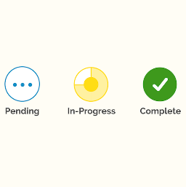
Scope of the project
Doctor Information
Remote Appointment request
Provide patients with information regarding registered doctors on the system by the admin.
Patients can remotely request appts. with doctors through mobile app.
Appointment Statuses
Notifications & reminder
The system admin controls and both all actors can view appointment for each timeslot and each patient.
As an admin approves the appt, the system notifies both parties and when the appt date approaches it reminds them.
Notes:
Make remote appointment request available to patients
Increased Patient Satisfaction
- reduced wait times
Display available doctor information to the patients
Reduced Missed Appointments

Slide 9
Specific objectives
To develop a user-friendly mobile app enabling patients to easily book, reschedule, or cancel appointments.
To offer patients detailed doctor information, including specializations, qualifications, and patient reviews through the mobile app
To provide a web app for hospital health officer with elements for efficient appointment management.
To integrate a feedback mechanism in the mobile app for patients .
Notes:
Make remote appointment request available to patients
Increased Patient Satisfaction
- reduced wait times
Display available doctor information to the patients
Reduced Missed Appointments

Slide 10
Chapter Two
System Architecture
Our Doctor Appointment System uses the MVC architecture, which separates the system into three main components:
Model: This component manages the data, logic, and rules of the application. It is responsible for interacting with the database and processing data before presenting it to the user or updating it based on user actions.
View: This is the UI of the application. It presents data to the user and sends user commands to the Controller. The View consists of the web application interfaces for doctors and admins, and the mobile application interfaces for patients.
Controller: This component acts as an intermediary between the Model and the View. It listens to user inputs, processes them (often calling the Model to retrieve or update data), and updates the View accordingly.

Slide 11
System Components - mvc
Model Layer
View Layer
User: Represents users of the system, including admins, doctors, and patients.
Appointments: Represents appointments, including patient information, doctor information, date, time, and status.
Review: Represents feedback and ratings provided by patients.
Patients: Represents and holds details of patients.
Web Application Views:
- Admin Dashboard, Doctor Management, Appointment Management, User Management
Mobile Application Views:
- Patient Home Page, Doctor List, Appointment Requesting, Feedback Submission
Controller Layer
AuthenticationController: Handles login, registration, & authentication processes.
AppointmentController: Manages appointment creation, updating, rescheduling, and cancellation.
DoctorController: Manages doctor information and schedules.
PatientController: Manages patient information & actions.
ReviewController: Manages feedback and reviews submission and viewing.

Slide 12
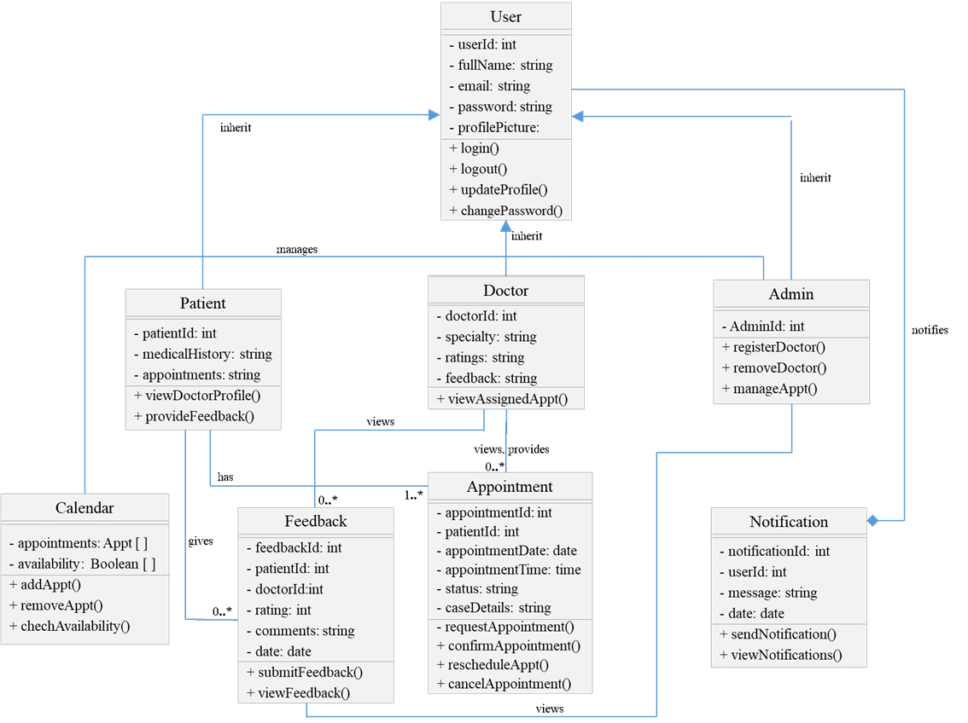
Class Diagram
Notes:
Make remote appointment request available to patients
Increased Patient Satisfaction
- reduced wait times
Display available doctor information to the patients
Reduced Missed Appointments

Slide 13
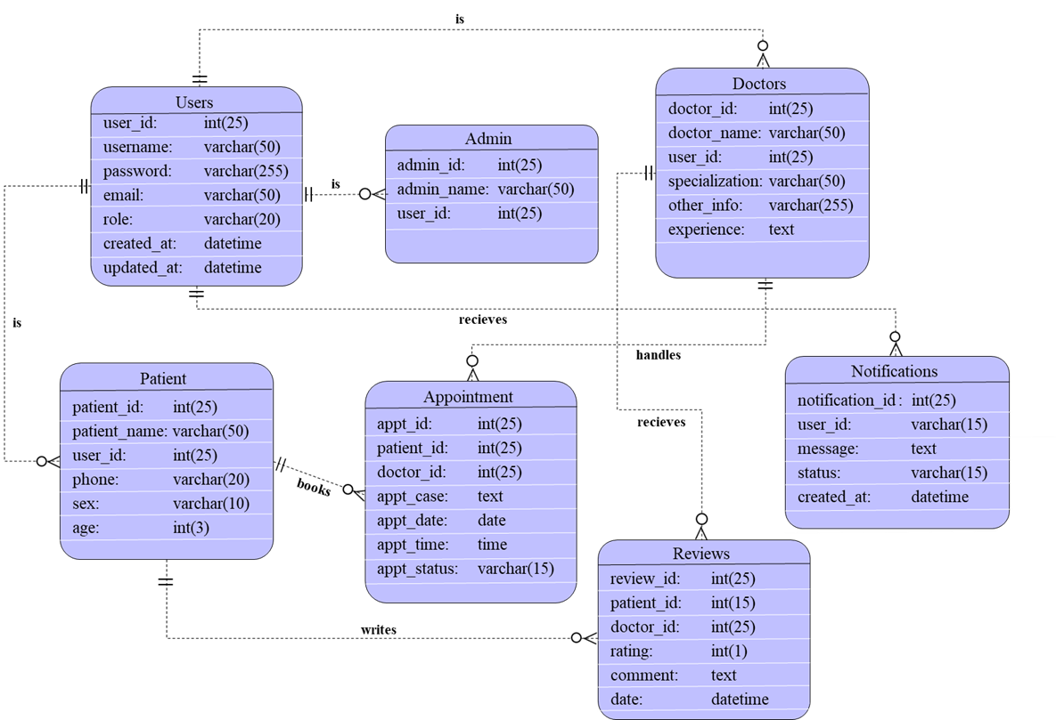
Database Design
ER Diagram
Notes:
Make remote appointment request available to patients
Increased Patient Satisfaction
- reduced wait times
Display available doctor information to the patients
Reduced Missed Appointments

Slide 14
Chapter THree
User Interfaces
The user interfaces (UI) of the Doctor Appointment System are designed to cater to the needs of different user roles: patients, doctors, and admins/health officers. They are based on availability of resources like mobile phones.

Slide 15
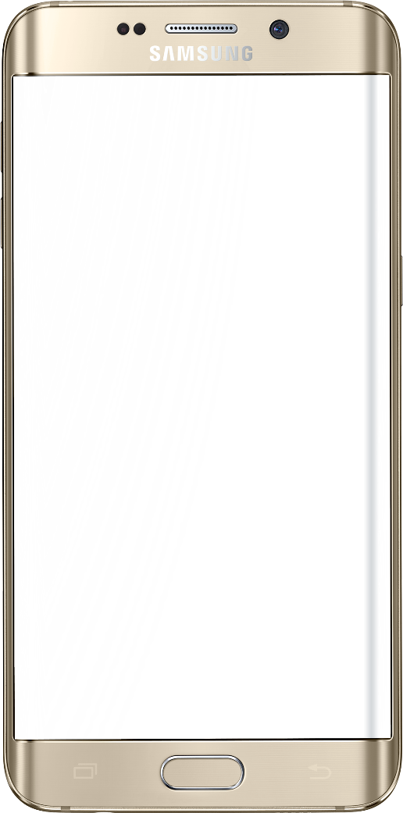
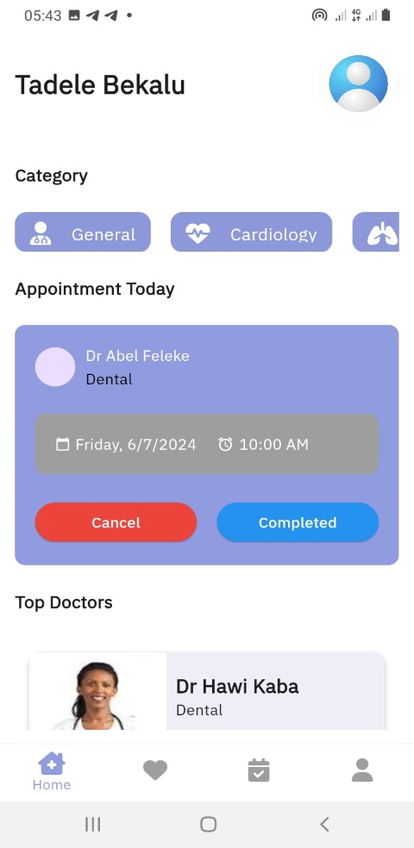

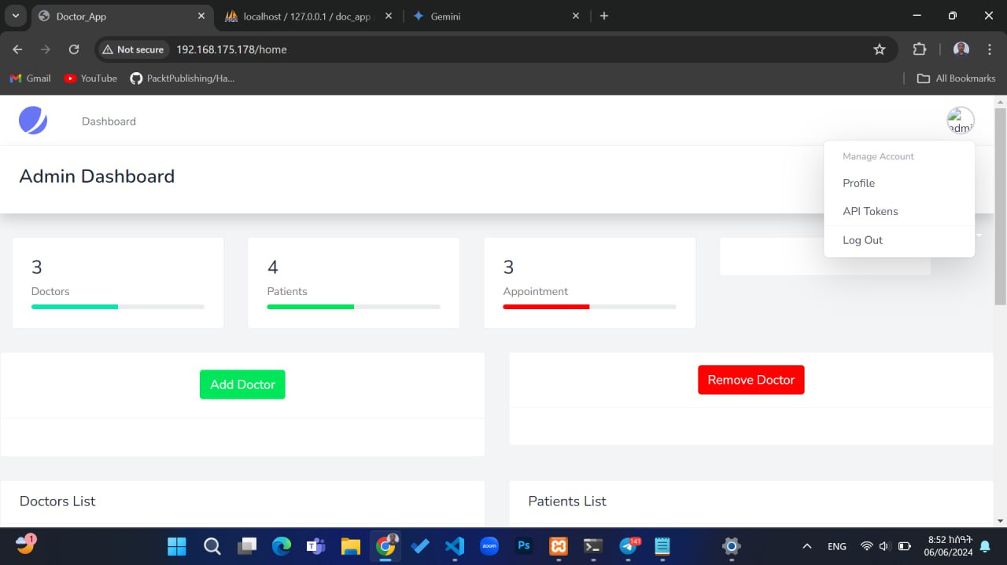


Home page
What is the purpose of this page?
On the patient app – it displays list of registered hospital doctors
On the Admin part – it displays number of appointments, patients, doctors, and different tables.
On the doctor side – it displays list of assigned appointments with patients.

Slide 16

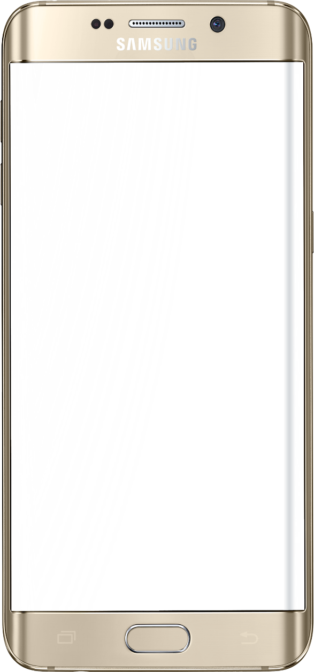
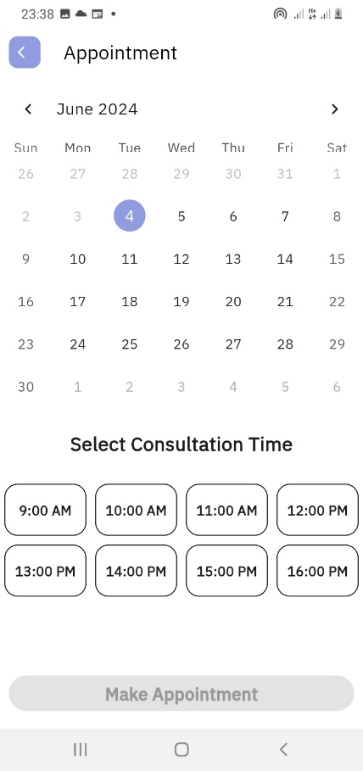
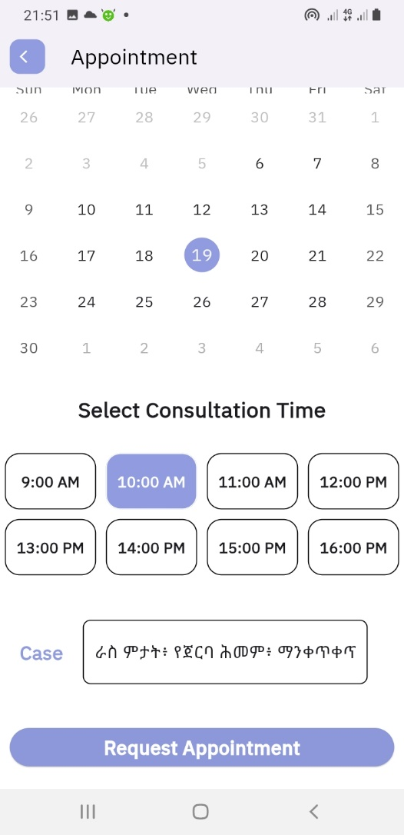
ReQuest Page
What is the purpose of this page?
A patient requests appointment by picking date, selecting time and writing cases about the symptoms of feeling.

Slide 17
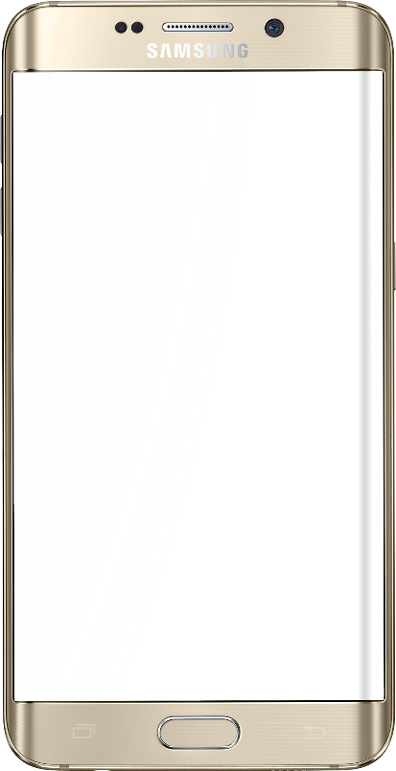
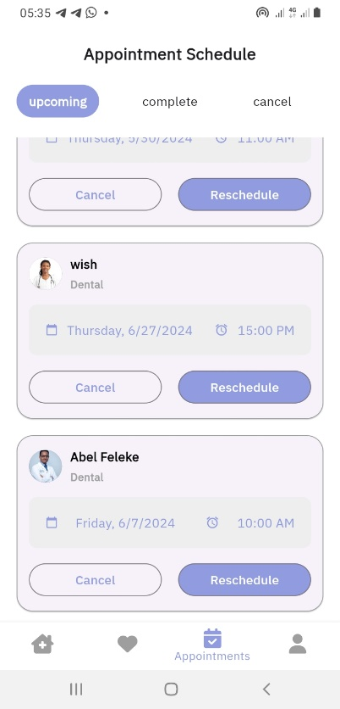
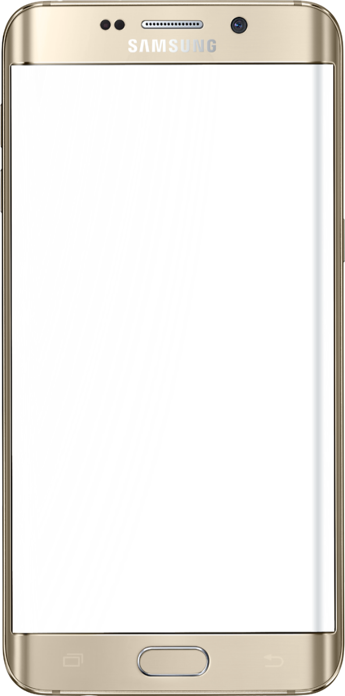
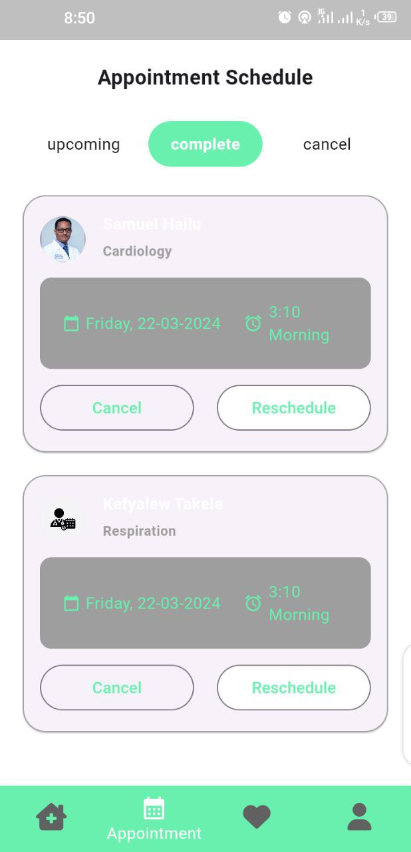
Appointment Statuses
Pending | Approved | Completed
There are three statuses under which an appointment requested passes through.

Slide 18





Project analysis slide 4
Tools used in implementation
Figma
Flutter
Laravel
Android Studio
VS Code

Slide 19
Chapter FOUR
Testing Methodologies
Testing is an improvement phase where defects and bugs are identified and resolved before the final product or service is released to users.
We conducted different types of testing to check each system module and components perform as intended like API testing, unit testing, integration testing, and functional testing.
Notes:
Specially by using invalid data input, high user load

Slide 20

UNIT TESTING
Unit testing involves testing individual units of code (functions, modules, classes) in isolation from other parts of the system.
We focused on testing core functionalities like appointment request, checking appointment status, and user authentication.
While performing unit testing on image, patient profile photo was not loaded.

Slide 21
Validation and Results
We apply manual testing procedures for most testing. For API testing we used Postman API testing technique.
While we perform testing, we identified some issues and bugs those need to be resolved. We addressed them by analyzing the test results and the codebase.
Unit testing of the Laravel API components, integration testing to ensure seamless interaction between the backend and the Flutter patient app, and functional testing to verify the system meets user requirements.

Slide 22
Continued….
Here is a sample test case:
Test Case ID: TestCase3
Unit to Test: appointment request page
Item Name | Test Description | Expected Results | Actual Results
Past date selection | When past dates are to be selected | The dates should not be clicked. | A date is not clickable if it is already a past date.
Proper date selection | When the coming dates are selected | The system should show the selected date making it different. | System highlights the date a patient selects.
Time selection | When the coming dates are selected | The system should display timeslots. | Timeslots are displayed and if one is selected, it is highlighted.
Already booked Timeslot | When a patient requests appt on a time already appt is booked. | The system should prevent selecting an already booked timeslot on the same date. | Error message: “The date and time you select is already booked.”
Request button | When proper calendar & time is not selected | The button should not respond nothing. | The button is not clickable.
Request button | When proper calendar, time is selected & patient clicks it | A patient can successfully request appointment. | The button is enabled and the patient successfully request appointment.

Slide 23
Chapter Five
Challenges Faced
During the implementation of the project there were many challenges that hinders us from going as we intend to do.
The usual development methods for appointment systems might not be suitable due to the literacy level of our local community.
When we were trying to gather requirements by going Arba Minch General Hospital, there was a lack of trust between us and the hospital staff. They were concerned that sharing information with us might compromise patient and hospital privacy. This concern prevented us from collecting the crucial information we needed.
Moreover, we were in struggle with time management and scheduling.

Slide 24
Future enhancements
To broaden accessibility and user reach, future developers could consider adding support for additional languages like Gamotto and Amharic especially within the mobile app, accommodating diverse linguistic preferences and improving user engagement.
Currently our system does not support payment transactions. For those who want to enhance this project in the future, we recommend exploring opportunities to integrate with real-time banking systems and different mobile payment services to streamline financial transactions securely and efficiently.
Recurring appointment is also a great deal for the project which enables convenient booking for regular check-ups and ongoing treatments, ensuring you never miss a beat in your healthcare journey.

Slide 25

Balanced scorecard slide 10
THANK YOU

